Slide 1
CS 419: Production Rendering Area Lights
Eric Shaffer

Slide 2
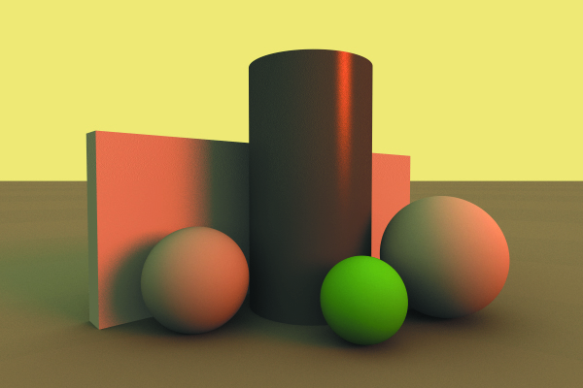
Objectives
Understand how area lights are modeled and rendered
Understand the idea of an environmental light
Be able to implement both

Slide 3
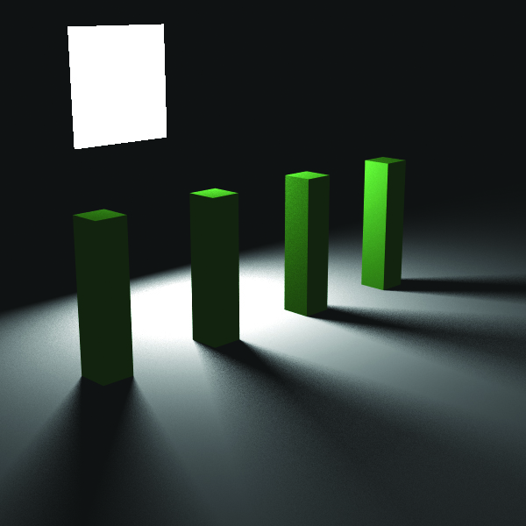
What is an area light?
An area light has a finite area
In addition to position, orientation, color, and luminance
Adding area lights greatly increases the realism in a lit scene
You get soft shadows as opposed to just hard-edged shadows
Area lights require more sampling per pixel
Longer render times

Slide 4
Implementing Area Lights
Area lights can have different geometries
Circle, rectangle, sphere, etc.
RTftGU implements an emissive material class
Any geometric object can then be made into a light
Need to estimate the incident radiance from the light on a point p
Three possible techniques
Shoot shadow rays to points sampled on the light surface
Shoot shadow rays in the solid angle subtended at p by the light object
Shoot rays by sampling the BRDF at the point p

Slide 5
Sampling the Light Surface
To determine incident radiance at a hit point p
Generate shadow rays
Originating p
Directed to a sample point s_{i} on the surface of the light
Example: a hemispherical light surrounding p
The light must be able to provide
Uniformly sampled points s_{i}
The normal at the point s_{i}
For what geometries would this be easy? Which would be hard?

Slide 6
Sampling the BRDF
To determine incident radiance at a hit point p
Generate rays
Originating p
Directions distributed according to the BRDF
i.e. sample hemisphere around p possibly non-uniformly
Example: (a) is uniform and undersamples, (b) samples BRDF

Slide 7
Importance Sampling Revisited
There are situations in which sampling the BRDF is less efficient
Choosing the most efficient sampling method for a situation is an application of importance sampling

Slide 8
What to do?
RTftGU chooses to
Sample the light for rectangular, circular, and spherical lights
Sample the entire hemisphere for environment light
We also need to be able to render the light itself

Slide 9
Estimating Direct Illumination
We need to compute exitant radiance at point p’
For direct illumination, we gather only illumination from lights
We neglect indirect light reflected off other surfces
Using the area form of the rendering equation:
For a single area light the Monte Carlo estimator for the integral is

Slide 10
Estimating Direct Illumination
We have n sample points
p() is the probability distribution function over the light surface
p() can be hard to determine in general
In practice use uniform distribution
Recall

Slide 11
Sources of Noise with Area Lights
Penumbra can be noisy
Why?
So if a hit point is in a penumbra it will require a large number of samples to resolve correctly
If the area light is large, the estimator can exhibit a lot of variation
So it will take a lot of samples to converge
Why? It has to do with

Slide 12
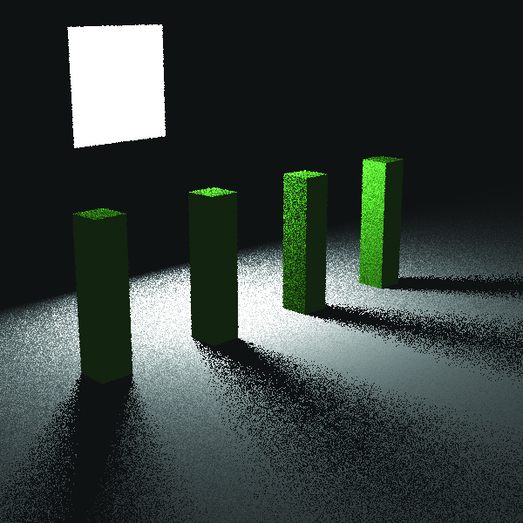
Example
(a) 1 ray per pixel (b) 100 rays per pixel

Slide 13
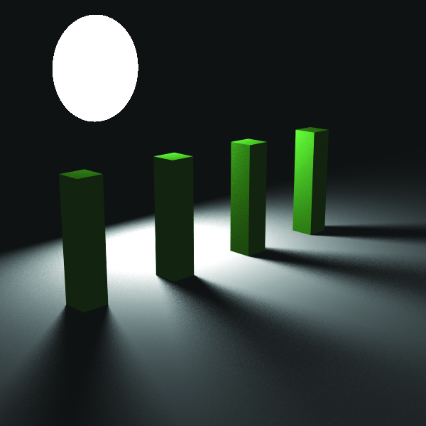
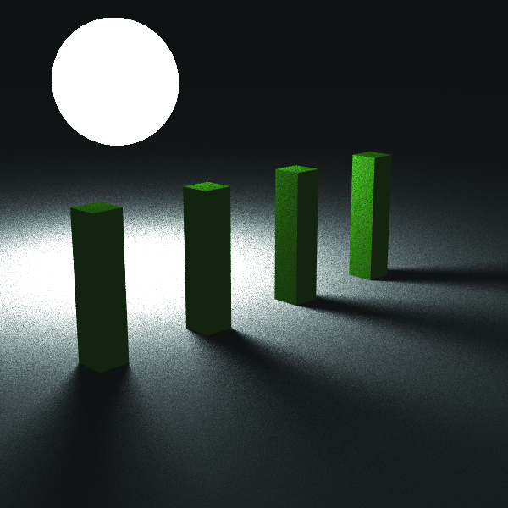
Example
(a) Disc Light (b) Spherical Light

Slide 14
Why is the Spherical Light Noisy?
Both lights use 100 rays per pixel
The spherical light uniformly samples the surface
The cos term in G() varies significantly
Note that the shadow shapes are relativlely insensitive to light geometry

Slide 15
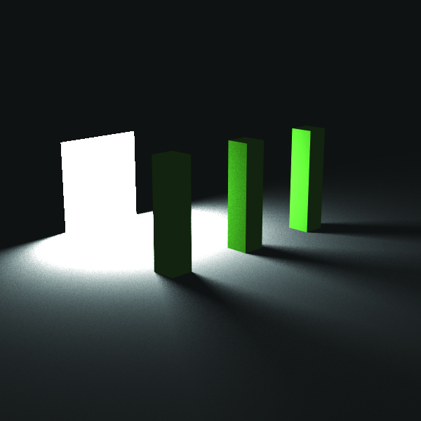
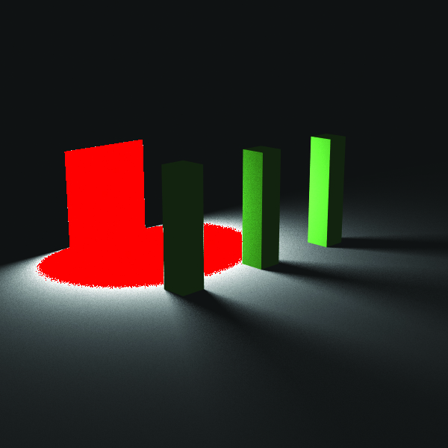
Overflow
The area light touches the plane
Note that overflow occurs around the light….
Why?
Can fix this in several ways
Keep lights away from objects
Use a PDF that includes a 1/d² term
Use the hemisphere rather than area form of the rendering equation

Slide 16
Environment Light
An Environment Light
Is an infinitely large spherical (or hemipsherical) light
Surrounds the scene
Emissive material with possibly spatially varying color
Shoot shadow rays using cosine distribution
Use hemisphere form of the rendering equation
Monte Carlo Estimator is

Slide 17
Example
Environment lights simulate outdoor lighting conditions
Here we have
yellow environment light
orange directional light
ambient occlusion

